Slide 1

Project 7: Email Marketing
BY PEACE NGOZI AGHEDO

Slide 2
Part 1
Plan Your Email Campaign

Slide 3
Marketing Objective & KPI
Marketing Objective - To get 40 new students to enroll for the Udacity DMND course through 3 email campaign between May 23rd and June 10^{th.}
KPI - Conversion Rate

Slide 4
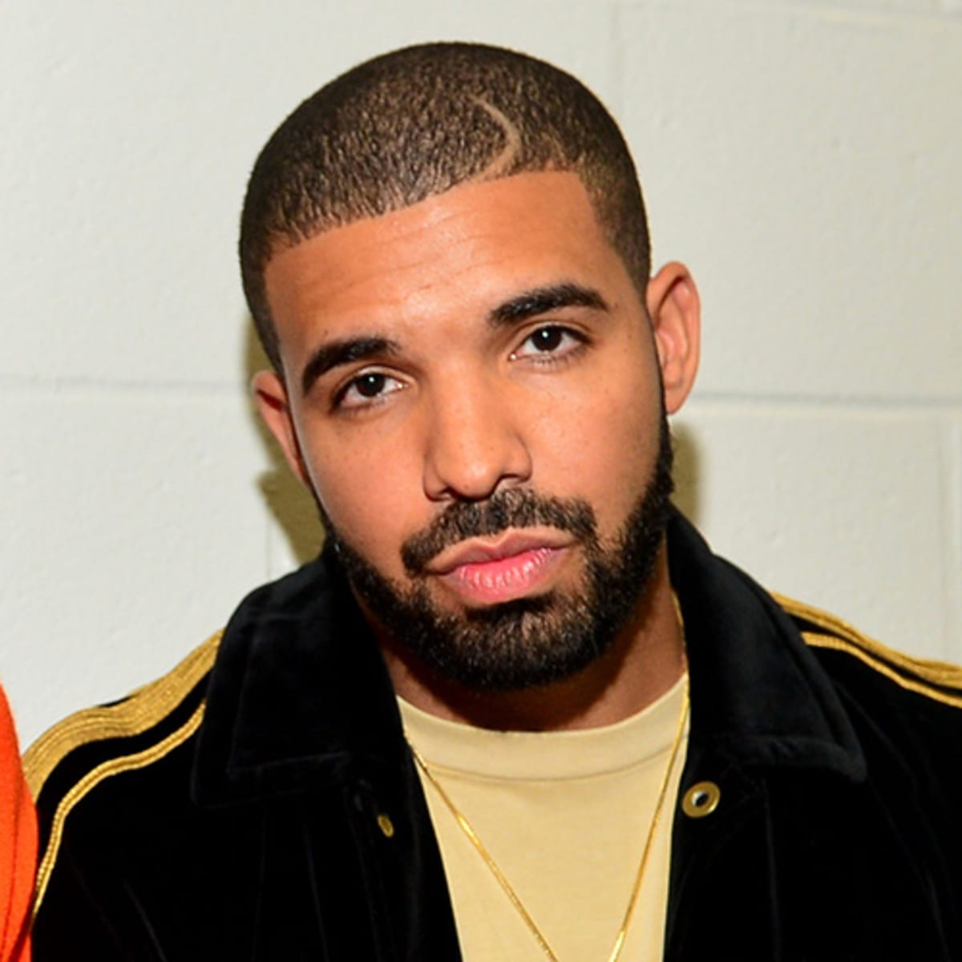
Target Persona
Background and Demographics | Target Persona Name | Needs
AGE: 40 GENDER: Male MARITAL STATUS: Married NUMBER OF CHILDREN: 3 COUNTRY: Nigeria STATE OF RESIDENCE: Edo EMPLOYED: Yes ANNUAL INCOME: 1 million naira HIGHEST CERTIFICATION: Masters Degree | MATTHEW | Sufficient internet network. Projects to practice Digital Marketing. Better work and better cash inflow. Tutorial videos
Hobbies | Goals | Barriers
Play FIFA PES Travel Singing Dancing Chess | A better job Does not see self in this same industry in the next 3 years. Sees self as a high profiled Digital Marketer in the next 3 years. | High cost of data poor Internet Financial constraints Too many responsibilities at work.

Slide 5
Email Series
Email 1: Launch your new Digital Marketing Career with Udacity.
Email 2: Susan’s Career Switch Story
Email 3: Enrol now!
Registeration into the Udacity digital marketing nanodegree closes June 10th.

Slide 6
Part 2
Create Your Email Campaign

Slide 7
Content Plan: Email 1
Overarching Theme: 3-5 Sentences
General | This email is intended to create awareness on the Udacity digital marketing program by providing relevant information. The objective is to encourage subscribers who have been nurturing the thought of acquiring digital marketing skill to engage the mail by signing up for the program.
Subject Line 1 | Master required skills for a successful Digital Marketing Career
Subject Line 2 (for A/B testing) | Begin your Digital Marketing Journey from the comfort of your home
Preview Text | Join our Digital Marketing Nanodegree Program
Body | Udacity Digital Marketing Nanodegree Program This program is built in partnership with industry pioneers like HubSpot, google, Moz, amongst others. It entails relevant knowledge you need to explore the full range of digital marketing specialties and a broad foundation for digital marketing expertise. In the course of this program, you stand to benefit; mastering the use of social media to scale up your business develop and run real-world campaigns get a 360-degree understanding of digital marketing, etc. With Udacity, learning is interactive and at your pace and convenience. Also, you are guaranteed an effective digital marketing skill that will be beneficial to you and your brand. Globally, over 6000 professionals have enrolled and benefitted from the course. Join this community and supercharge your career.
Outro CTA 1 | Learn more
Outro CTA 2 (for A/B testing) | Read more

Slide 8
Content Plan: Email 2
Overarching Theme: 3-5 Sentences
General | This email is intended to build the interest of subscribers in the Udacity digital marketing program to subscribers. The objective is to make subscribers engage the mail and to consider the program
Subject Line 1 | From Store Keeper to Digital marketer
Subject Line 2 (for A/B testing) | Freelancer: Susan’s success story
Preview Text | Success with Udacity
Body | Hi there, allow me introduce you to Susan. Susan is a 25years old young lady. She is a graduate of the South California business school where she finished the top of the class. After graduation she got job as a store keeper in a shopping mall, but her salary could rarely help pay for her upkeep. One day she stumbles upon the Udacity Digital Marketing Nanodegree ad campaign on her mailbox and enrolled. Despite her tight schedule she finished the classes and did all her projects and graduated. Today, Susan is not just a certified Digital Marketer, an employee of Google, where she is the Team Lead of the Marketing department. Susan’s story can be your story. You too can become digital marketer and get employed by a multi-million company. Sign up today for the Udacity Digital Marketing Nanodegree and join the train to success.
Outro CTA 1 | Read more
Outro CTA 2 (for A/B testing) | Learn more

Slide 9
Content Plan: Email 3
Overarching Theme: 3-5 Sentences
General | The objective is conversion. This email is targeted at subscriber’s, reminding them of the registration deadline and convincing them to sign up before June 10th.
Subject Line 1 | Become a certified Digital Marketer (Last Day). Enroll now!
Subject Line 2 (for A/B testing) | Wait no more! Enroll now for the Udacity Digital Marketing Nanodegree
Preview Text | Final call! Deadline of Udacity Digital Marketing Nanodegree registration.
Body | Hey there, I see you are yet to register for the Udacity Digital Marketing Nanodegree Program. Are you having second doubts about the program? Opportunities like this don’t come around every day. Don’t miss his golden opportunity to be part of something great. Enroll now and don’t miss your chance to become a world class Digital Marketer. Registration closes 11:59pm June 10th and classes begins June 30^{th.} See you soon!
Outro CTA 1 | Enroll now
Outro CTA 2 (for A/B testing) | Sign up now

Slide 10
A/B Test Overview
2 components of my email were created (email #1 and email #2), alongside 2 Subject line (subject line 1&2) and 2 CTA (Outro CTA 1 and Outro CTA 2. I divided my mail list into 2 groups of equal halves- group A and group B.
The steps I will follow:
First, I will test for the subject line
To group A, I will send email #1 with subject line 1 “Master required skills for a successful Digital Marketing Career” and Outro CTA 1 “Learn more”.
To group B, I will send email #2 with subject line 2 “Begin your Digital Marketing Journey from the comfort of your home” and Outro CTA 2 “Read more”.
I will analyze the click rate and CTA to see which performed better and stick to the higher performing subject line. This will be the mail I will send to my full mail list.
A/B testing is important because it helps one understand which email version performs better. It helps understand what keywords can increase the click rate of the email. Also, it helps achieve a higher CTA for a campaign.

Slide 11
Calendar & Plan
Email Name | Planning Phase | Testing Phase | Send Phase | Analyze Phase
Email 1 | May 23rd - 24th | May 25th | May 26th | May 30th – 31st
Email 2 | May 25th - 26th | May 27th | May 30th | June 1st – 2nd
Email 3 | June 1st – 2nd | June 3rd | June 6th | June 8th – 10th
Week One |  |  |  |  | Week Two |  |  |  |  | Week Three
M | T | W | T | F | M | T | W | T | F | M | T | W | T | F
23 | 24 | 25 | 26 | 27 | 30 | 31 | 1 | 2 | 3 | 6 | 7 | 8 | 9 | 10
Email 1
Email 2
Email 3
Color Key | Planning Phase | Testing | Send Phase | Analyze Phase

Slide 12
Part 3
Build & Send

Slide 13
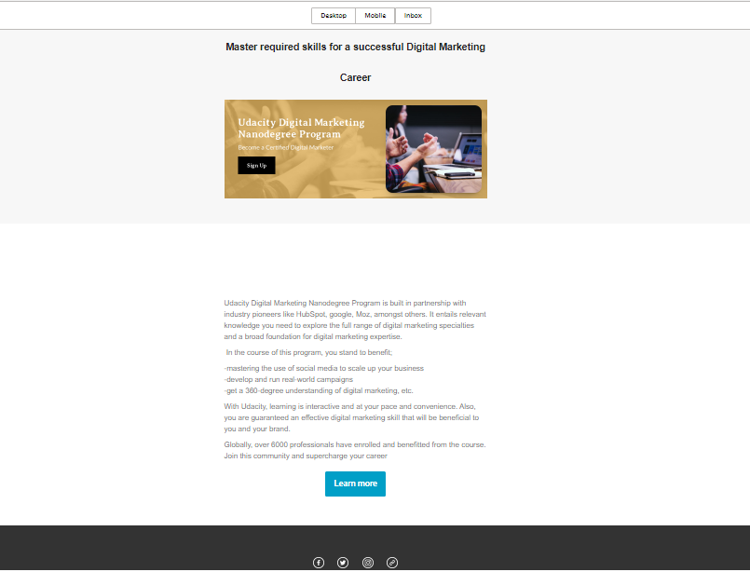
Draft Email

Slide 14
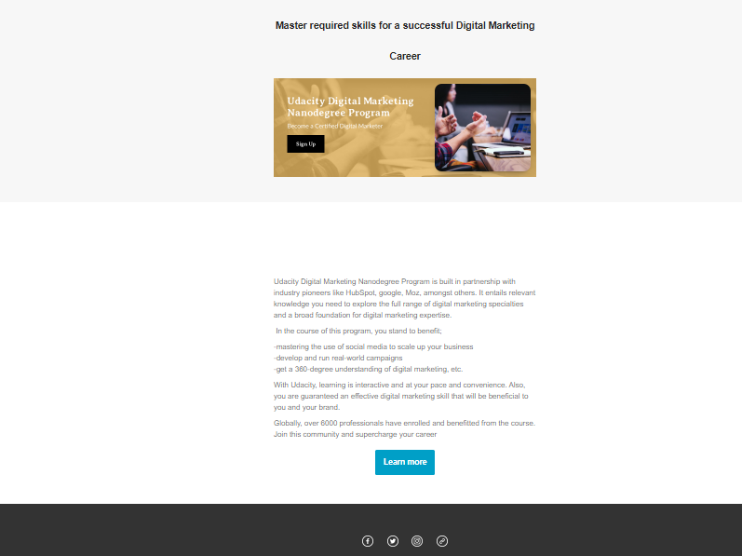
Final Email

Slide 15
Part 4
Sending & Analyzing Results

Slide 16
Results Email #1
After you have hit send on the first email of your campaign, you can spend some time analyzing the results.
Calculate the Open Rate
Results and Analysis
Sent | Delivered | Opened | Opened Rate | Bounced
2500 | 2250 | 495 | 22% | 225

Slide 17
Results Continued Email #1
Results can be monitored within the first 24 hours of an email send, after a couple days or even after a week.
Calculate the CTR and the Conversion Rate
Results and Analysis
Clicked | CTR | Take Action | Conversion | Unsub
180 | 8.0% | 75 | 3.3% | 30

Slide 18
Final Recommendations
If a subscriber unsubscribes from my list, I would make sure to remove the person and other inactive subscribers from my email list. There is no need keeping persons who do not open promotional emails sent. This will help save cost and avoid being blacklisted.
Ill suggest that experiment be done with different visuals (especially email 2). I will attach a short video of Susan telling her story. The words should be condensed more Read and understand the survey results. Feedback should be treated seriously and urgently.
I’ll suggest the results of previous email campaign be analyzed by; tracking the reach of both email #1 and email #2, track Click and Open rates(to understand how subscribers engage with the campaign, so that I can restructure the message), Track unsubscribe rate (to ensure there is nothing discouraging in it) and finally, track number of bounces(to help scrutinize my email list and remove any inactive or invalid email address.

